Slide 1

Presented by Team : Team

Slide 2


Members of Team : Team

Slide 3
Introduction
Background
Tracking system for batches
Creating new batches
Viewing current trainers
Generating projection reports
Exporting batch & reports data
Goals
Add hidden logic to batch creation
Create batches with specific skills
Ability to add new trainers
Generate more projection reports and graphs

Slide 4
AssignForce Pipeline

Slide 5
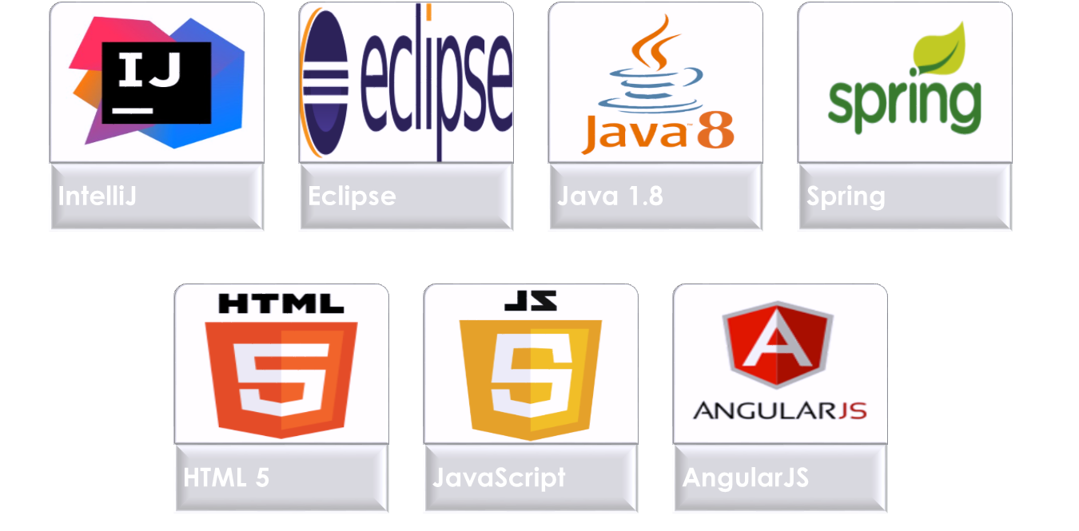
Technologies

